Slide 1
Have you worked in multi-subscription environment? What is Tenant ? (Azure lighthouse – Multiple tenant), sentinel (workbook)
What are Azure polices, give few examples? (Azure policy and Blueprint provide the rules and structure on the subscription)
What is UDR (User defined Route) Or Route table and how to configure it in Azure? (virtual appliance)
What are private endpoints in Azure?, Public endpoint, Bastion, Firewall, Ddos Protection, ExPress Route, Site to site , ASG, NSG, compute service (VM,VMSS,ACI,AKS,App Service, Function) , azure service, Publish repository on Linux server
What do you understand by IaC? - Ansible, Terraform
What is GitFlow branching model? (Feature branch, commit changes, Create PR, Code Review, Merge branch)
What tool do you use for creating Architecture in Azure? (Miro, Draw.io,
Communication → VNET to Vnet, Subnet, VM, Subnet to Subnet, VM to VM
Azure SQL & Sql Database -LRS, GRS (Data Migration assigstant tool), App service migration assistant tool
Azure DevOps Variable (Global Varibable then how will you change env for prod, test. (How to call Azure secret in DevOps pipeline
If 1 machine is full (no space in disk) and 2nd If machine is down then what will be first step ?
Classic editor & Yaml
Can you Write DevOPS pipel line YAML file in notepad for Kubernetes Deployment, Service via Terraform (Strategy & Steps). Azure DevOps Pipeline CICD Steps with Resource access. (Only selected user can execute pipeline) . How do you call Variable, Azure Keyvault in pipeline. How Azure function in CICD Pipeline ?
Difference between Azure IAAS, PAAS, SAAS. (How Azure durable function statefull work.)
VM & VM ScaleSet , Vnet peering, Azure Policies, (Backup & Restore)
Read and write (Post and Put) , Logic app (Consumption, standard), logic app exception handling, debug issue
How to call variable in yaml file. (global variable, local variable, dynamic varibale)
How to balance traffic (Load Balancer, Front door, application Gateway, traffic manager)
Canary, Blue Green Deployment , Helm chart, init container, SideCar
Long running job on Azure function (time out 2 min in logic app or function then how will you handle ?
Cloud infrastructure deployment, firewall and load balancing, networking, switching, backup and disaster recovery, high availability, enterprise and cloud storage management and technologies, databases and infrastructure capacity planning
Software packaging and automated deployment experience.
Do you have experience of managing kubernetes infrastructure in production environment?
Notes:
https://medium.com/geekculture/how-to-use-key-vault-secrets-in-azure-pipelines-658198f2eea6

Slide 2
? Experience with using Async IOT Communication mechanisms, such as MQTT- Sparkplug.
? Experience with using scripting languages for integration with various protocols.
? Experience with API definition and design for Application Consumption.
? Experience with Data modeling and Data Storage Design.
? Experience with writing and maintaining automated testing at the unit, integration, and functional test levels.
? Experience with source control tooling such as Git and following pull requests and peer code review guidelines.
? Ability to plan, estimate, and deliver highly focused and tested features and enhancements in a 2-week agile sprint cadence and releasing.
? Has strong written skills and the ability to effective communicate technical analyses and
results to business management
? Demonstrable knowledge and skills with network programming, distributed systems, security, uthentication, and authorization in distributed systems and the web
? Familiarity with various software architectures: service oriented architecture, microservices, event driven, serverless computing
? Experience with SQL, NoSQL, and Multi-modal database systems such as MySQL,
PostgreSQL, Snowflake, and CosmosDB, etc.
? Hands-on experience with public clouds such as Microsoft Azure, Amazon Web Services, or
the Google Cloud Platform and technologies (or an equivalent) such as:
? Azure DevOps CI/CD, ? Azure Key Vault, ? Azure IOT, EventHubs, Event Grid, Azure Functions
? Experience working with DevOps technologies such as Jenkins or Chef
? Container experience using technologies such as: ? Docker,? Kubernetes,? Helm,? AKS,? OpenShift, ? Service Fabric
? Strong experience in Data Ingestion and Integration
? Deep experience with high volume distributed event data processing
? Experience with caching strategies and technologies (such as Redis) in a distributed system
? At least one additional scripting language such as Powershell, Python, Perl, R, Ruby.,? RESTful/GraphQL API Design
? Configuration Management Tool experience

Slide 3
How would you design highly available and scalable architecture using azure resources load balancer, Virtual machine etc.

Slide 4
1. Microsoft Azure- PAAS - Azure VMs, Azure Storage Web Apps, Azure functions , Logic Apps, Azure Service bus
2. Azure AD and identity management
3. Azure SQL Database / COSMOS DB/MySql
4. Azure Storage : File, Blob etc..
5. DevOps Git / Azure DevOps/Jenkins
6. Dockers and Containers
7. Transformation tools and services for ex: Azure migration services
8. Certifications/Hands on expertise on Cloud platforms Azure. Good to have: 1. Azure IAAS: Azure VMs, VNET, Gateways, Firewalls, Load balancers, Azure Front Door, Radish Cache 2. Azure Data analytics solutions: Synapse, ADF , ML and cognitive solutions .
• Hands On expereince in Azure Solutions implementating Azure VM, Storage, Web Apps, Azure functions , Logic Apps etc. and help team members to resolve technical issues
• Understand end to end requirements, perform code implementations, Code reviews, Code configurations , Deployments and update documentation LLDs.
• Source code configurations branching, merging and handling code conflicts
• Exposure to DevOps CI-CD using Azure DevOps/Bitbucket/Jenkins etc.
• Exposure \ Knowledge of transformation from on-premis to Azure hosted solutions

Slide 5
Migration SQL Database to Azure sql database
1. Create Azure SQL Database (firewall access)
2. Schema backup and execute script
3. Azure datbase Migration Service (M1)
4. inside M1 go to new migration project
5. SQL server to Azure datbase migration wizard
Migration Onpremise SQL Database to Azure sql database
Data Migration assistant version 5.3

Slide 7
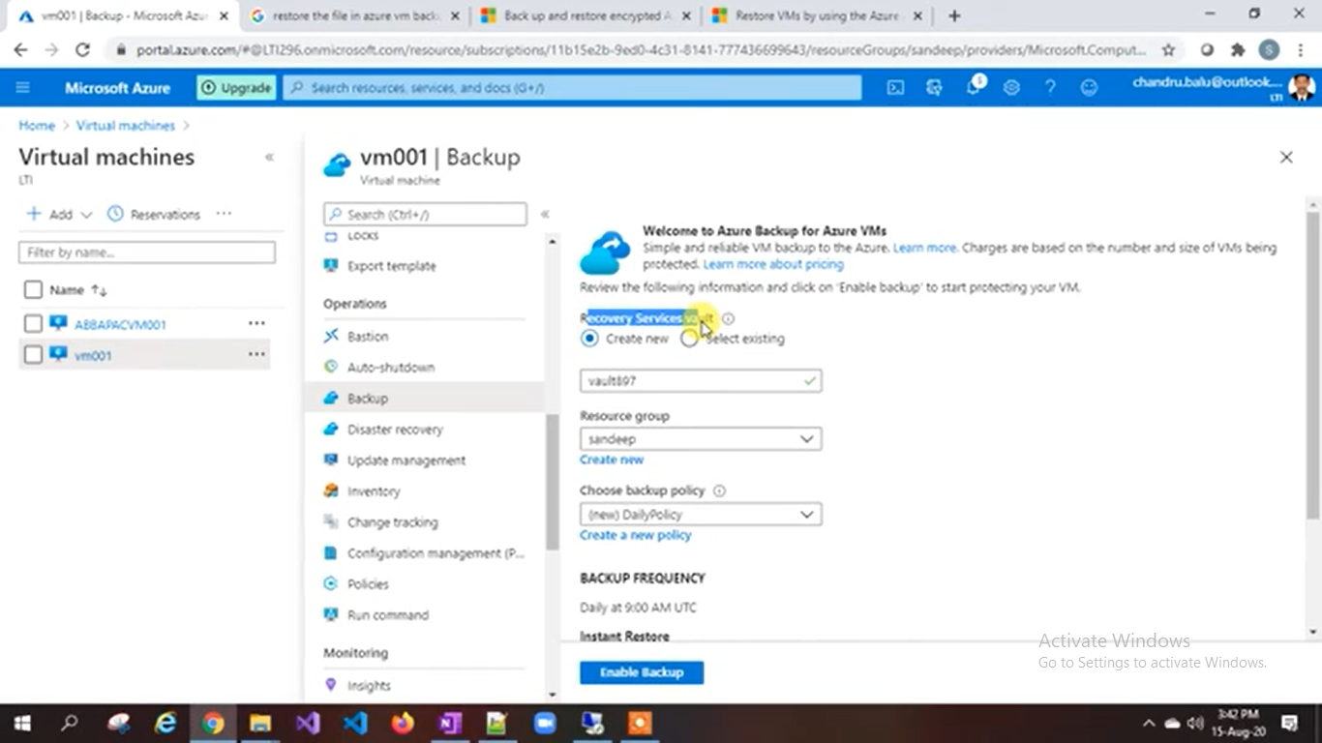

Slide 8
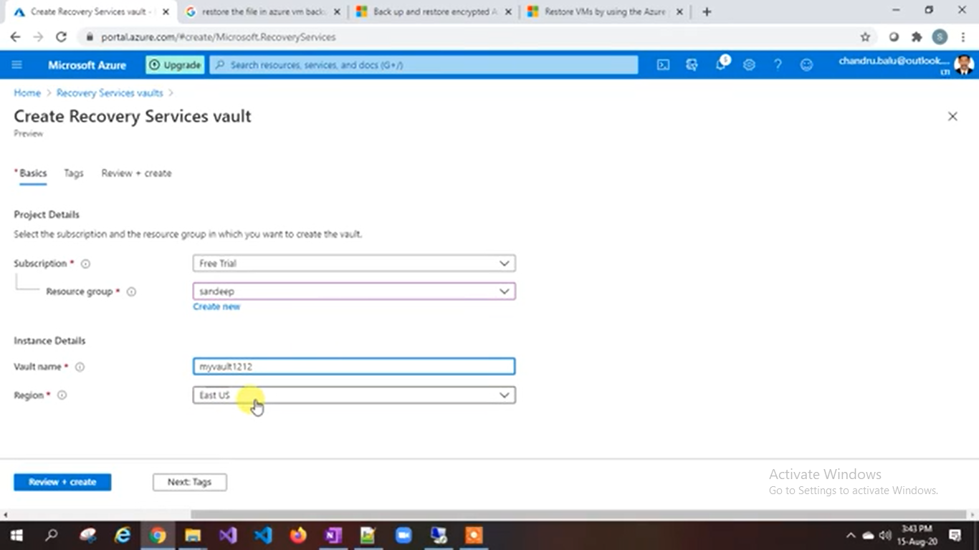

Slide 16
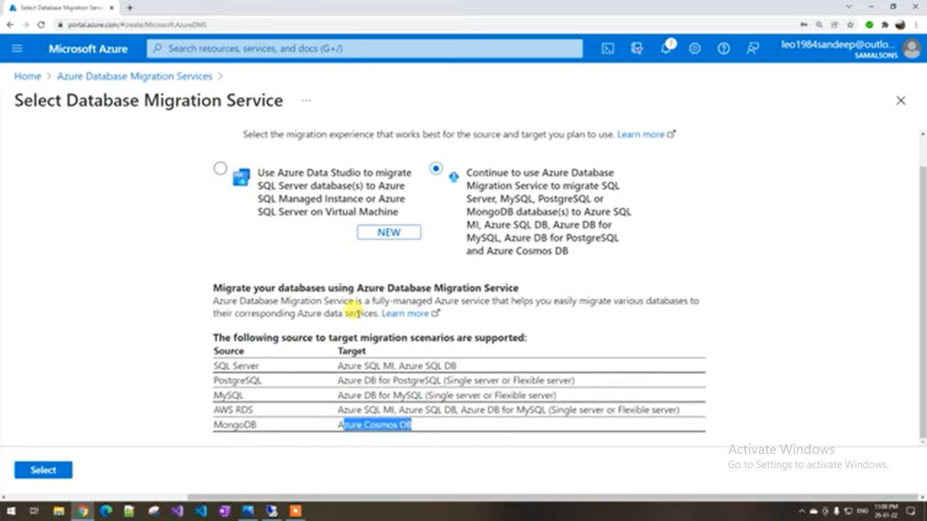

Slide 17
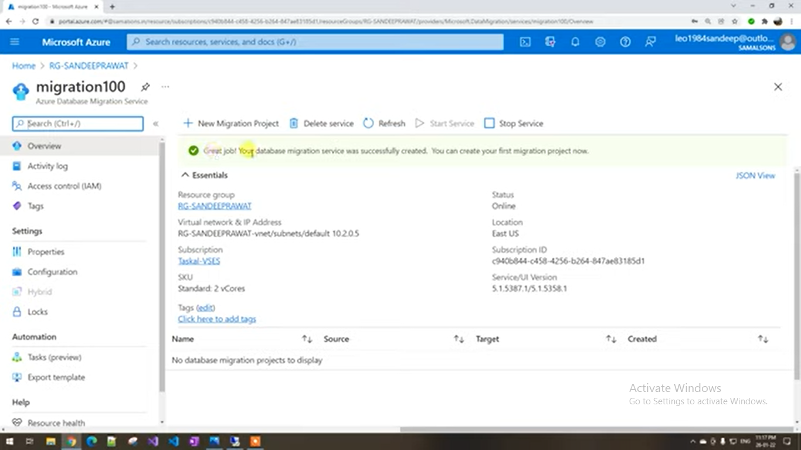
Azure database migration service

Slide 18
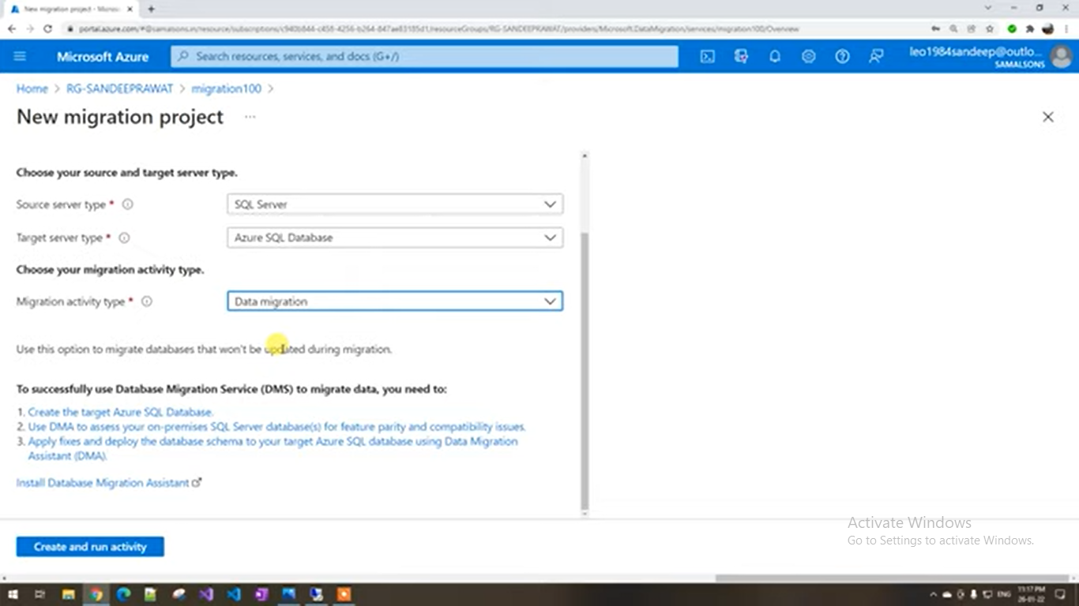

Slide 19
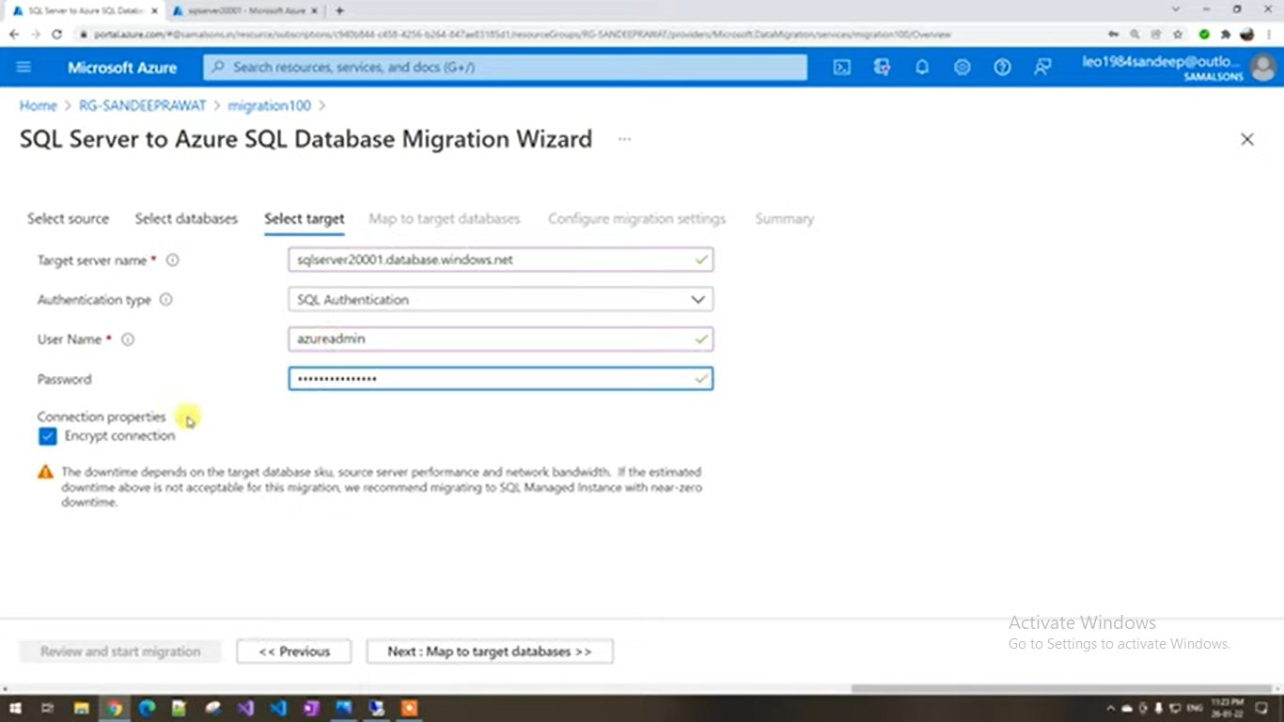

Slide 20
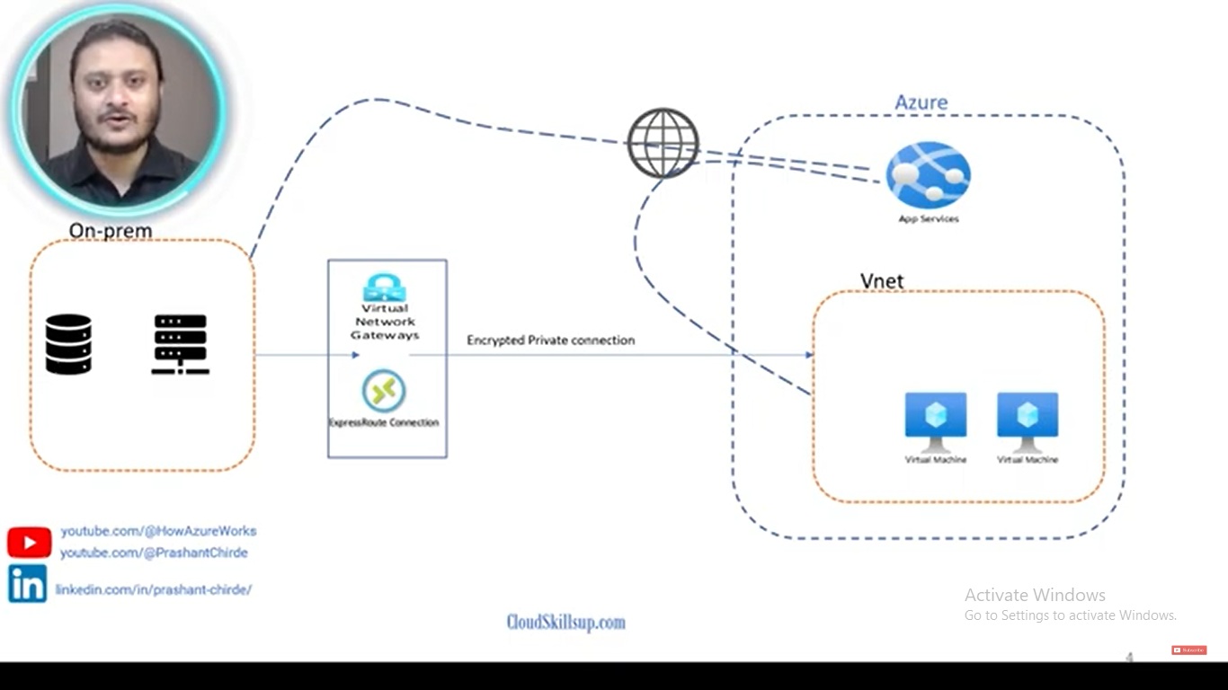

Slide 21
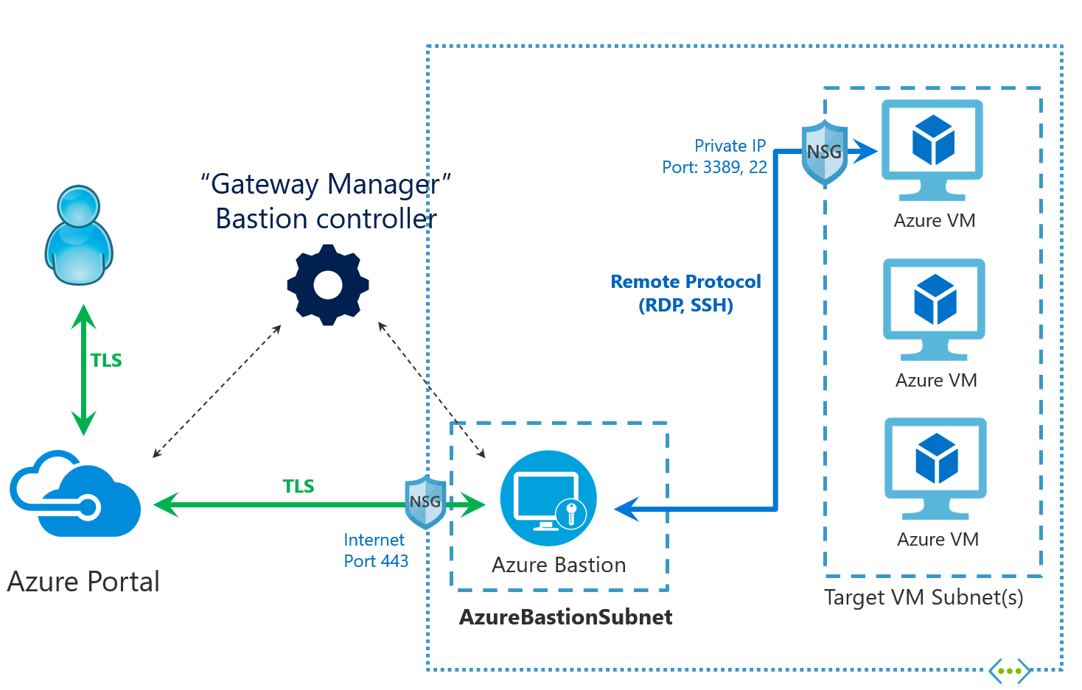
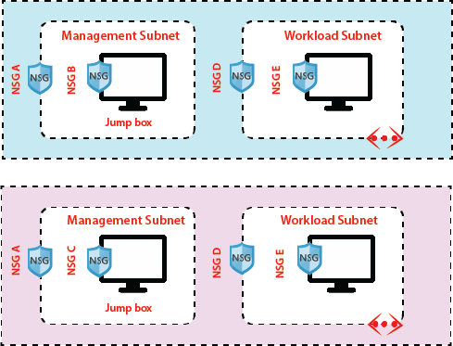

Slide 22
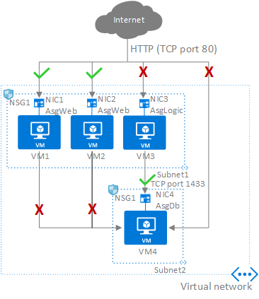
Application security groups enable you to configure network security as a natural extension of an application’s structure, allowing you to group virtual machines and define network security policies based on those groups.

Slide 24
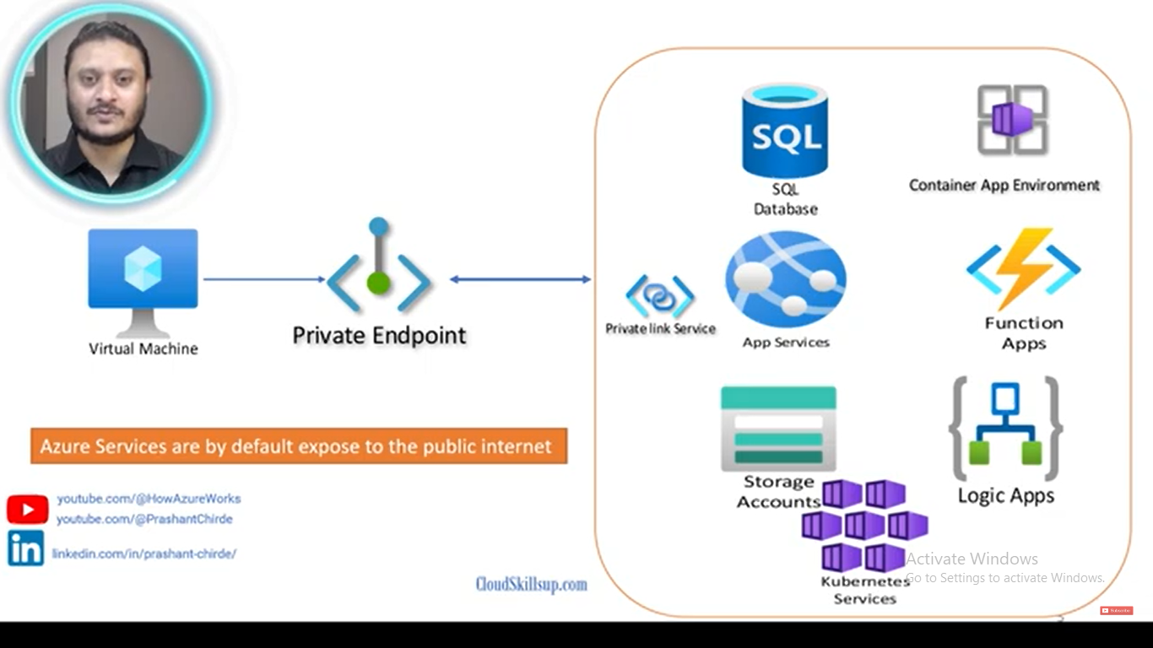
microsoft backbone

Slide 25
Infrastructure Fundamentals – i.e cloud networking, security, storage technologies (NAS & Object), IaaS compute, IP, DNS

Slide 26
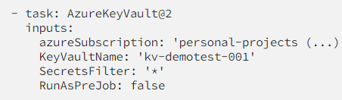
A tenant is an Azure Active Directory (Azure AD) entity. It's the directory in which users, groups, and applications are stored. A subscription is a billing entity that you use to organize access to cloud resources.

Slide 27
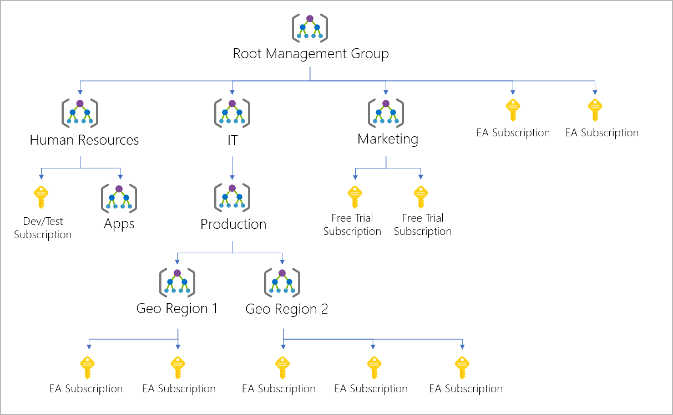

Slide 30
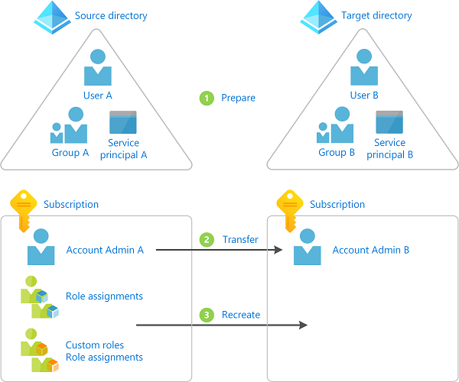
https://learn.microsoft.com/en-us/azure/role-based-access-control/transfer-subscription

Slide 31
Create Azure AD User [3 Methods With Examples]
Step-1: Access Azure Portal GUI.
Step-2: Create AD User.
Step-3: Specify User Type.
Step-4: Provide Identity and Password for User.
Step-5: Define group and roles for User.
Step-6: Define User Settings.
Delete Azure AD User.

Slide 32
https://learn.microsoft.com/en-us/answers/questions/661339/add-list-of-users-as-member-to-azure-ad-group-via
Notes:
https://learn.microsoft.com/en-us/answers/questions/661339/add-list-of-users-as-member-to-azure-ad-group-via

Slide 33
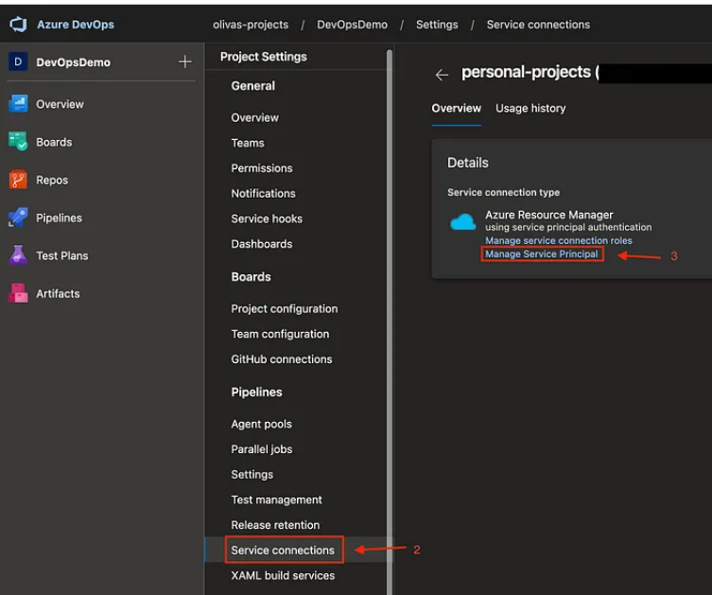

Slide 34
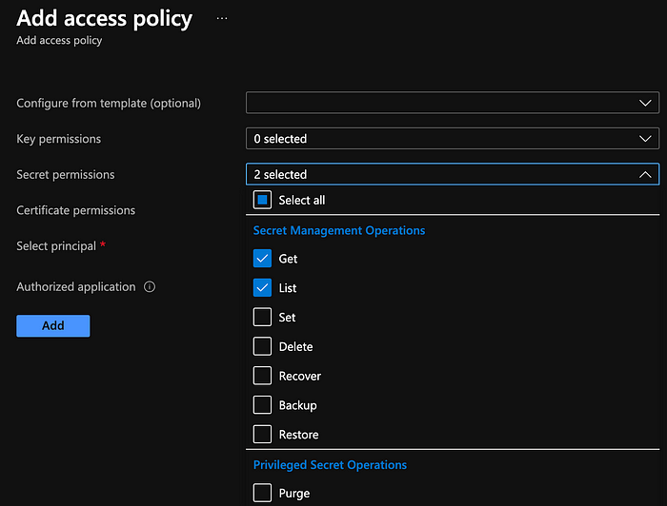

Slide 35
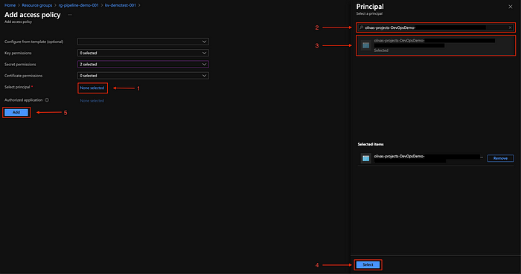

Slide 39
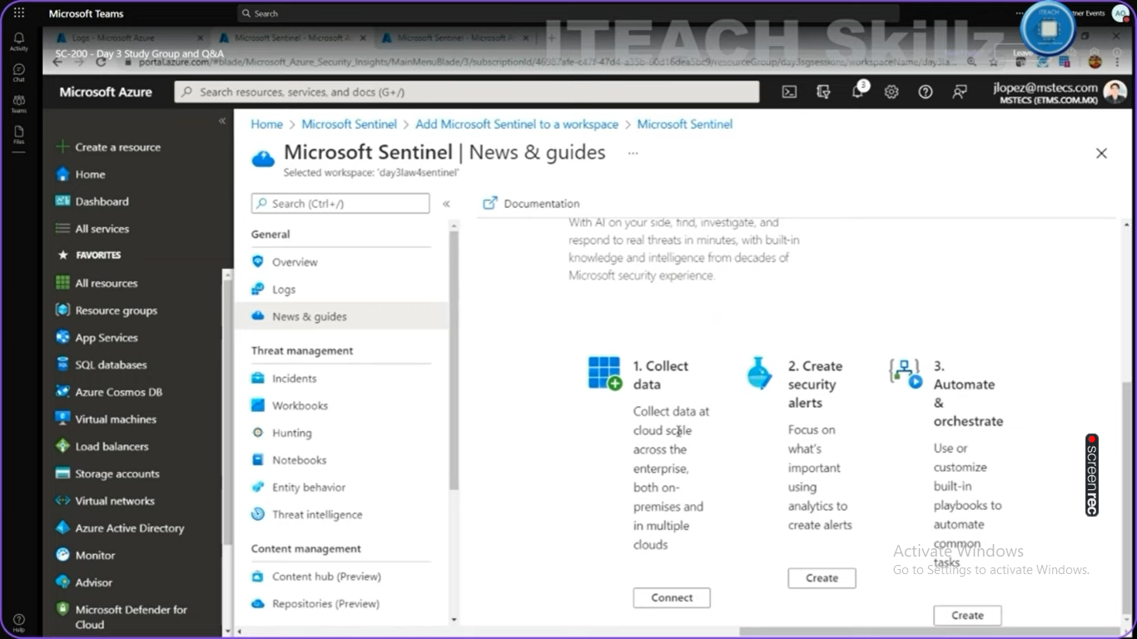

Slide 40
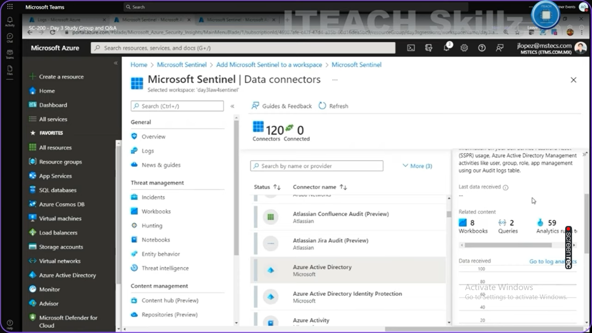

Slide 41


Slide 42
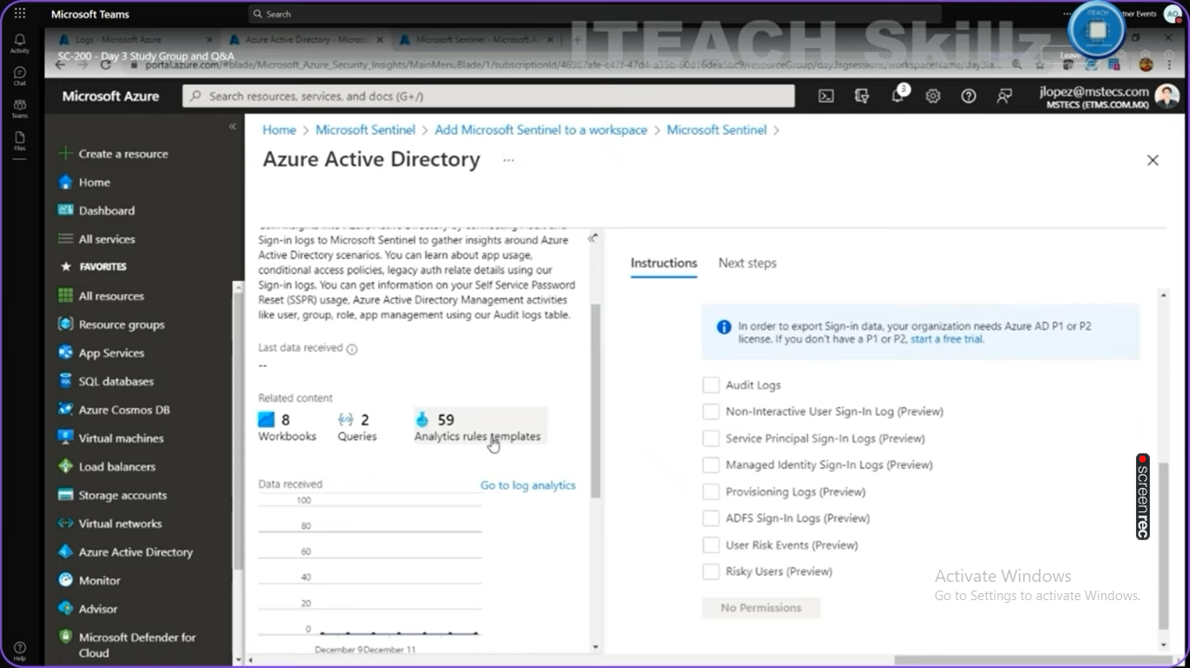

Slide 45
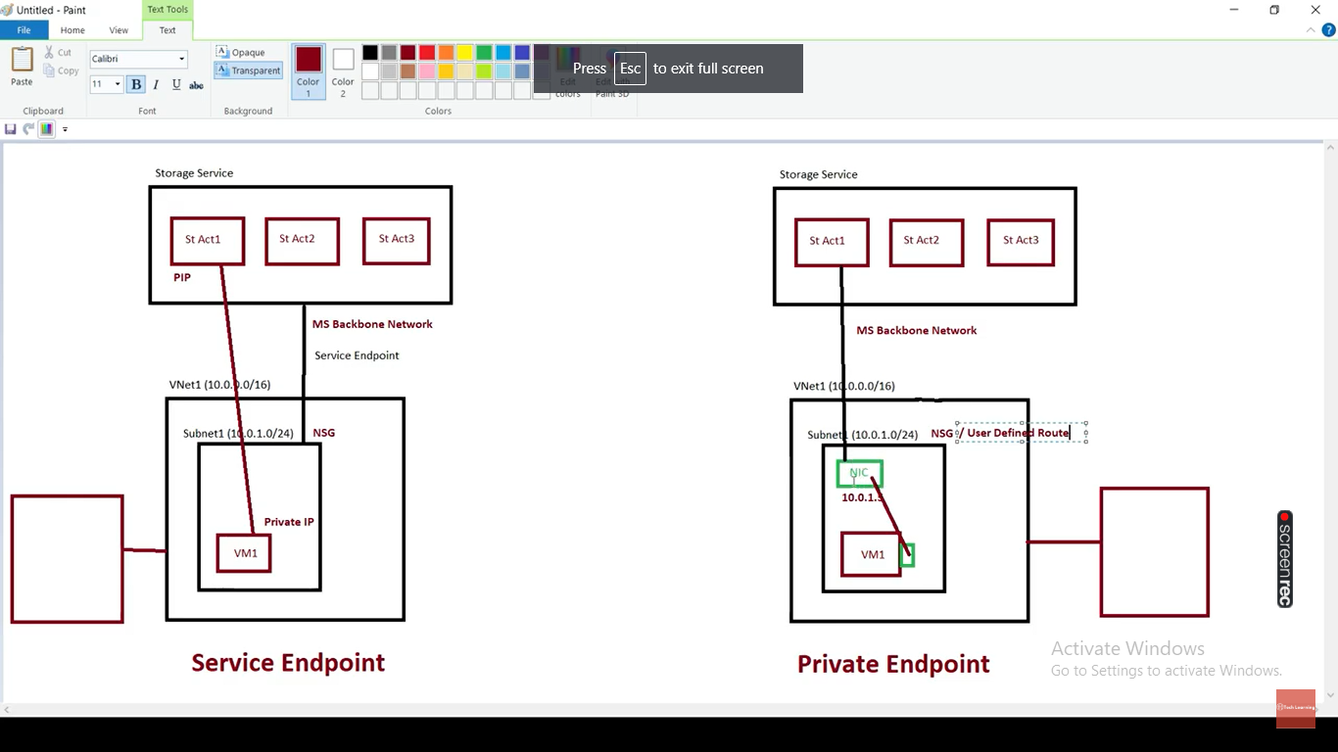

Slide 46
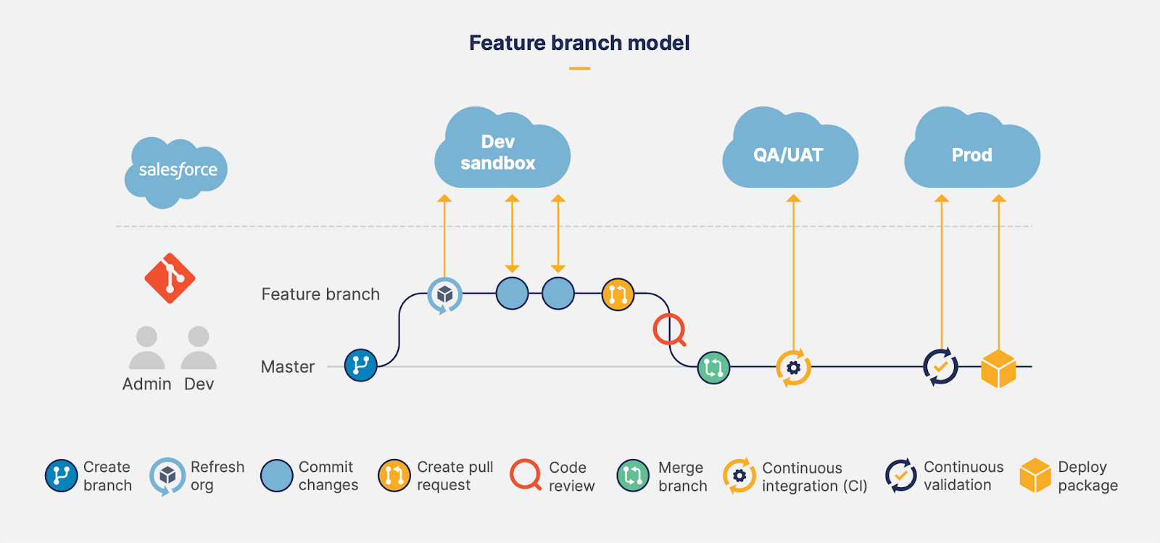
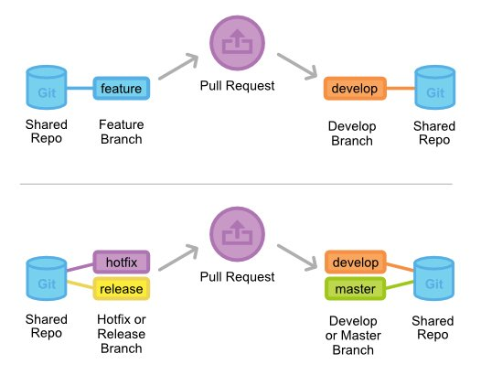

Slide 47
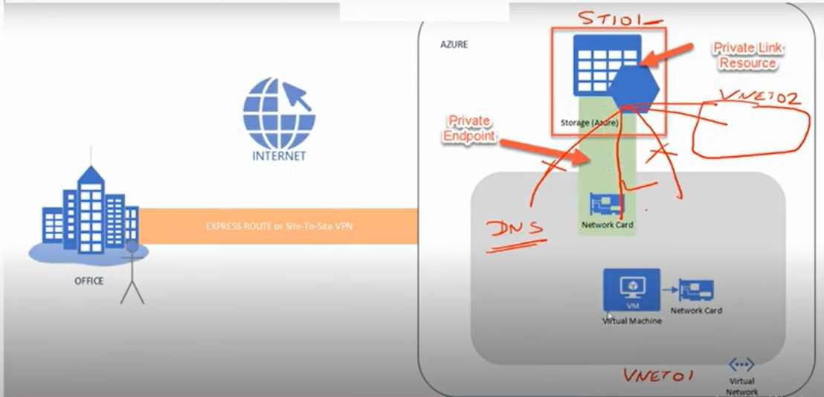

Slide 48
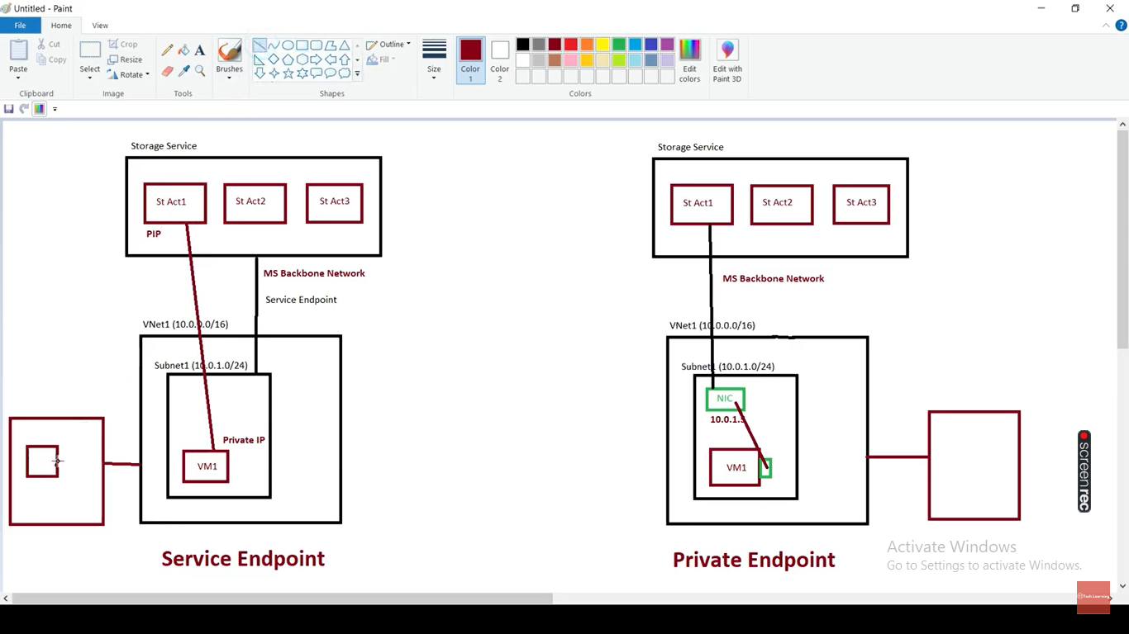

Slide 49
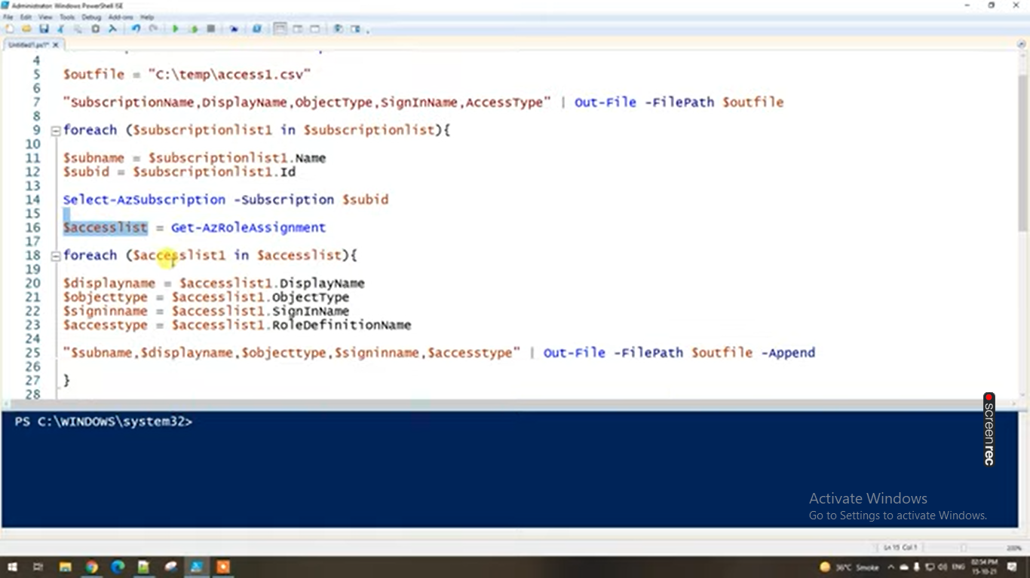

Slide 50
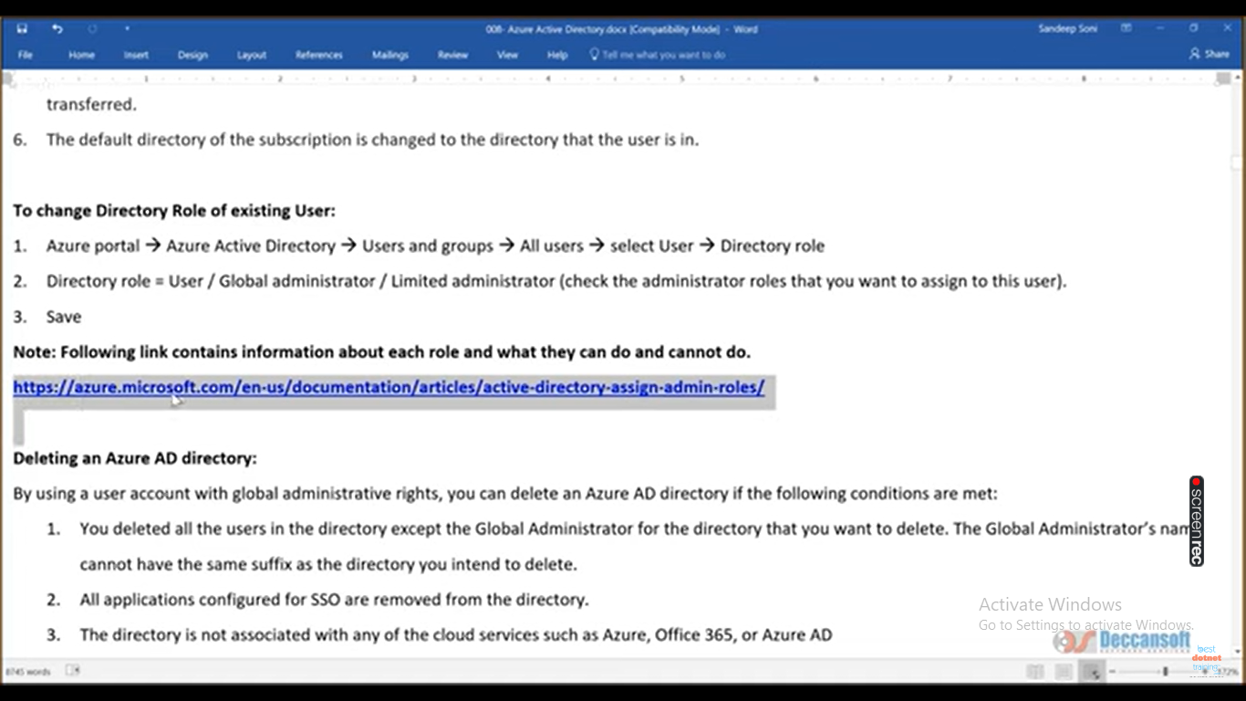

Slide 51
